Slide 1
Weekly Report
程文胜 2020.10.26-10.30

Slide 2
Weekly Report
Abstract
Content
End

Slide 3
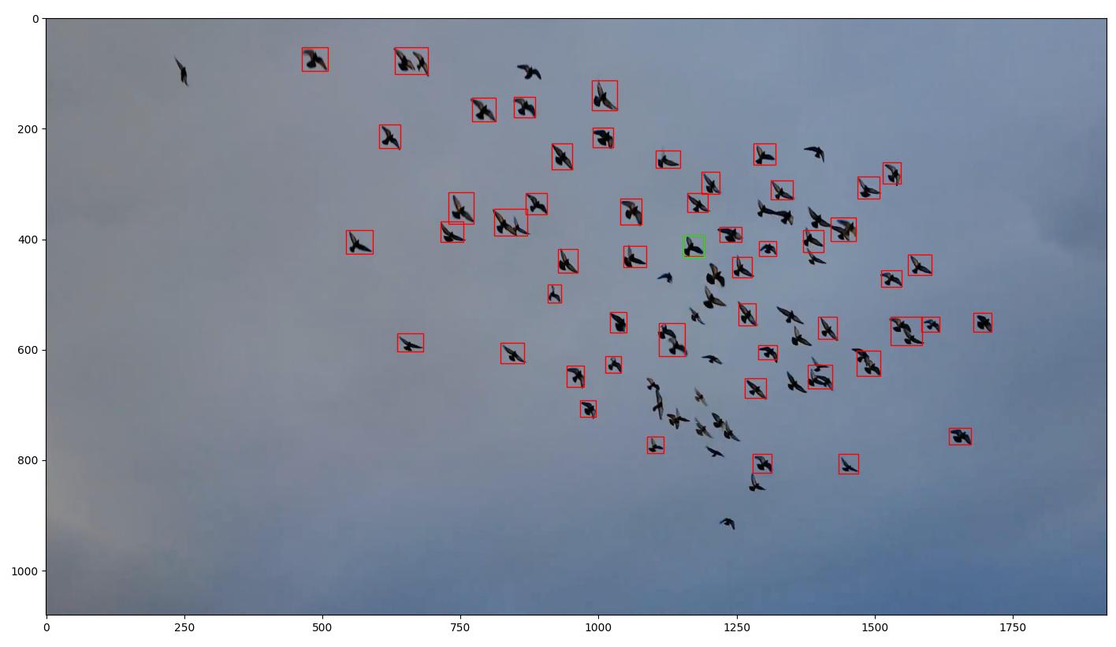
Abstract
This week I mainly focus on the Global Track framework and using it to generate detection results for each image.

Slide 4
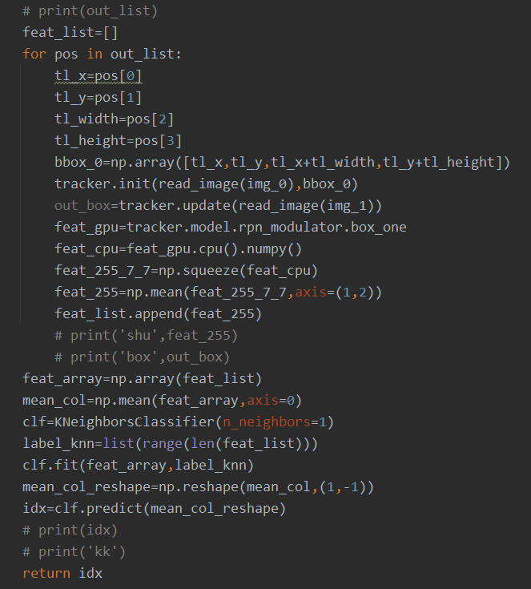
Content
I first get the initial box by finding the one nearest to the mean vector of the feature space. Since the original code has many nested models, using another return value would be messy, I use class member variable to get the feature after ROIAlign.

Slide 5
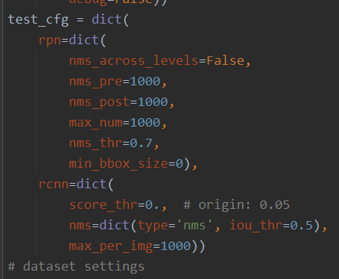
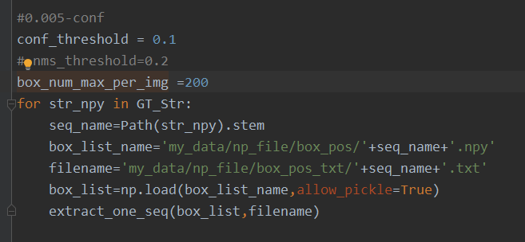
Content
I then use the initial box and the 1st frame as input, other images as the 2nd frame to get all boxes result on each image, including the 1st image. The result seems ok for later use(The img with green box is the 1st frame, and green box is the initial box we choose. Others are the 000100.jpg).

Slide 6
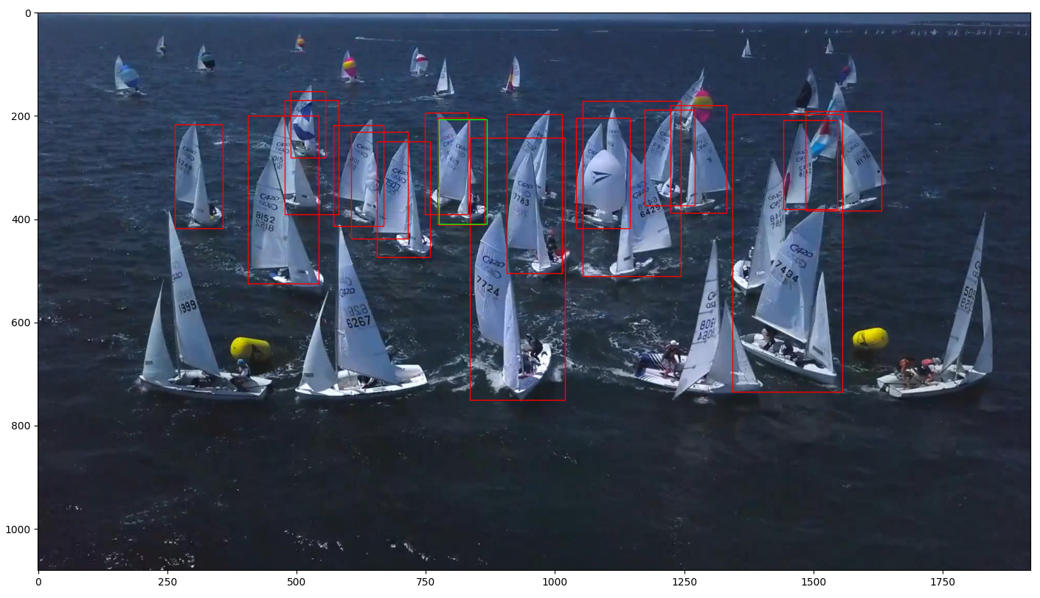
Content

Slide 7
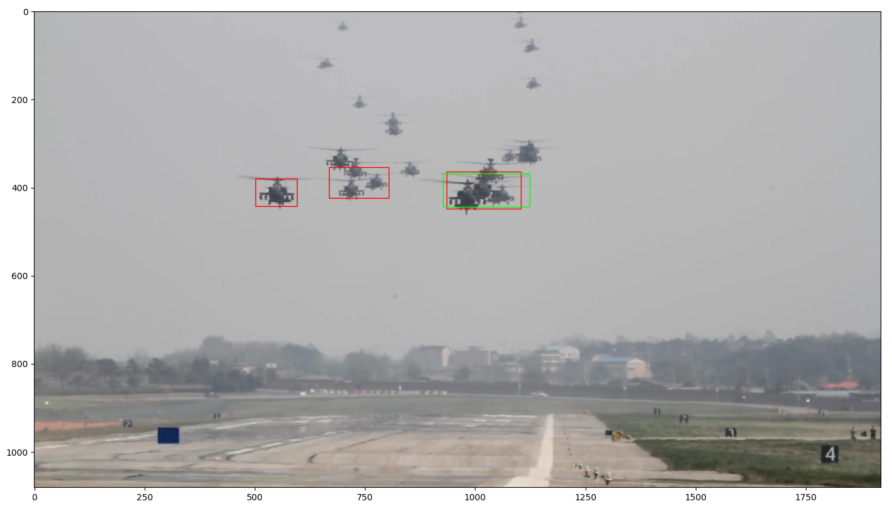
Content

Slide 8
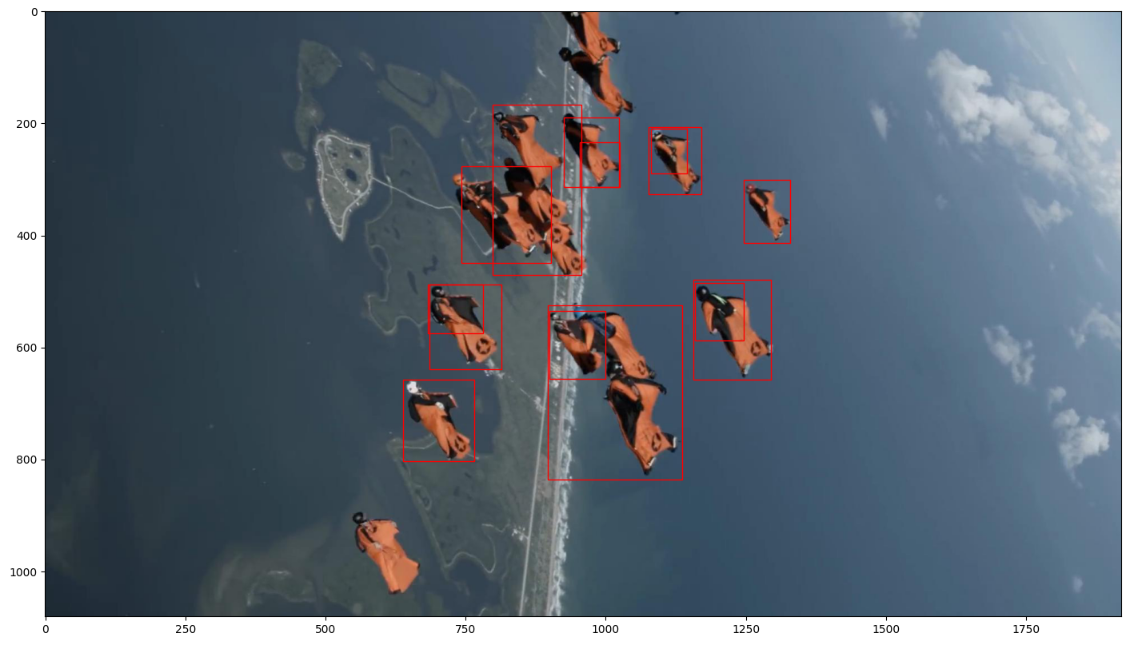
Content

Slide 9
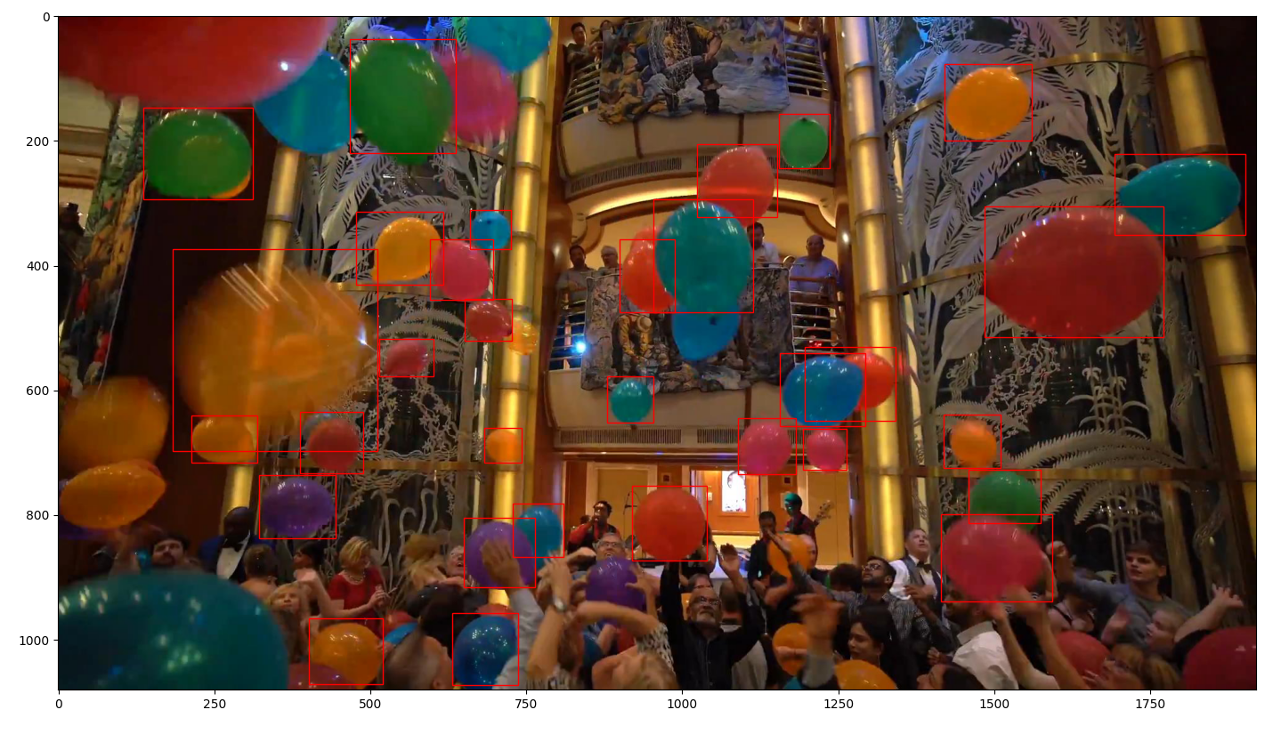
Content

Slide 10
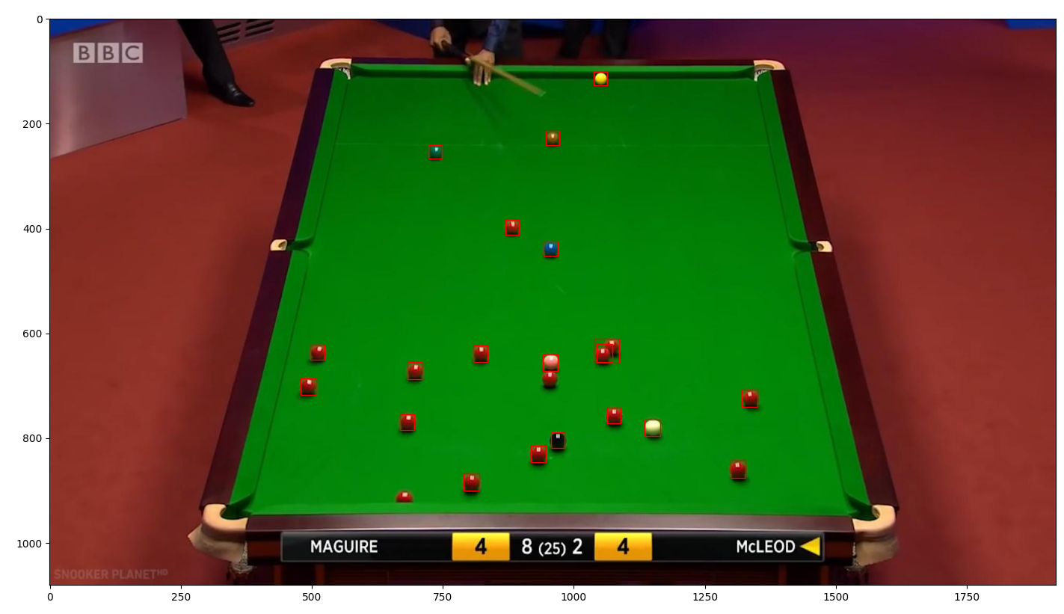
Content

Slide 11
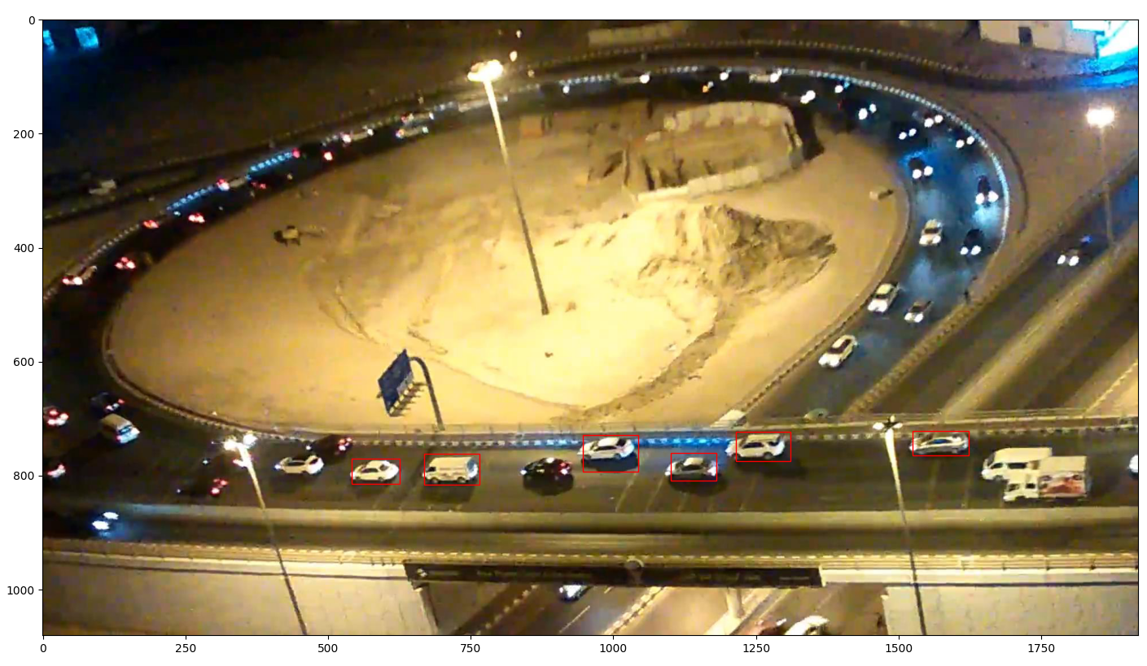
Content

Slide 12
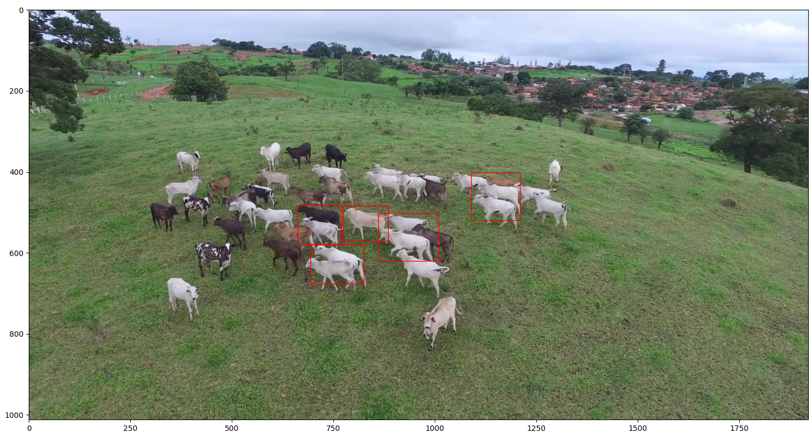
Content

Slide 13
Report End
程文胜 10.30

